Slide 1
Fair Housing in Delaware

Slide 2
Warm Up: How is the family in this story facing discrimination? Identify 2 ways.
In the 1950s, the Jackson family, a hardworking Black family, dreamed of moving to a better neighborhood. But every time they tried to buy a home, they were turned away—either told the house wasn’t for sale to them or denied a fair loan by the bank.
When they finally found a house, they were charged far more than white families had paid for similar homes. The area they moved into had recently been abandoned by white families, and the house was in poor condition. Still, it was the best option available.
Even after they moved in, the Jacksons faced unfair treatment. Real estate agents refused to help them look in better neighborhoods, and some neighbors made it clear they weren’t welcome. Because they were denied a fair loan, they struggled with high payments and little security.

Slide 3
Types of Discrimination
Restrictive Covenants
  Attached to the deed for the house
  Could not sell or rent the house to a non-white person
Blockbusting
  A technique used by realtors to have homeowners sell their house at cheap prices by instilling fear of a different race or class moving into the neighborhood
    Then resell at a higher price
Redlining
  Federal government (FHA) drew lines in cities across the country to separate “hazardous” and “declining” from “desirable” and “best,” for giving out loans
    Used ethnic composition to determine the ratings

Slide 4
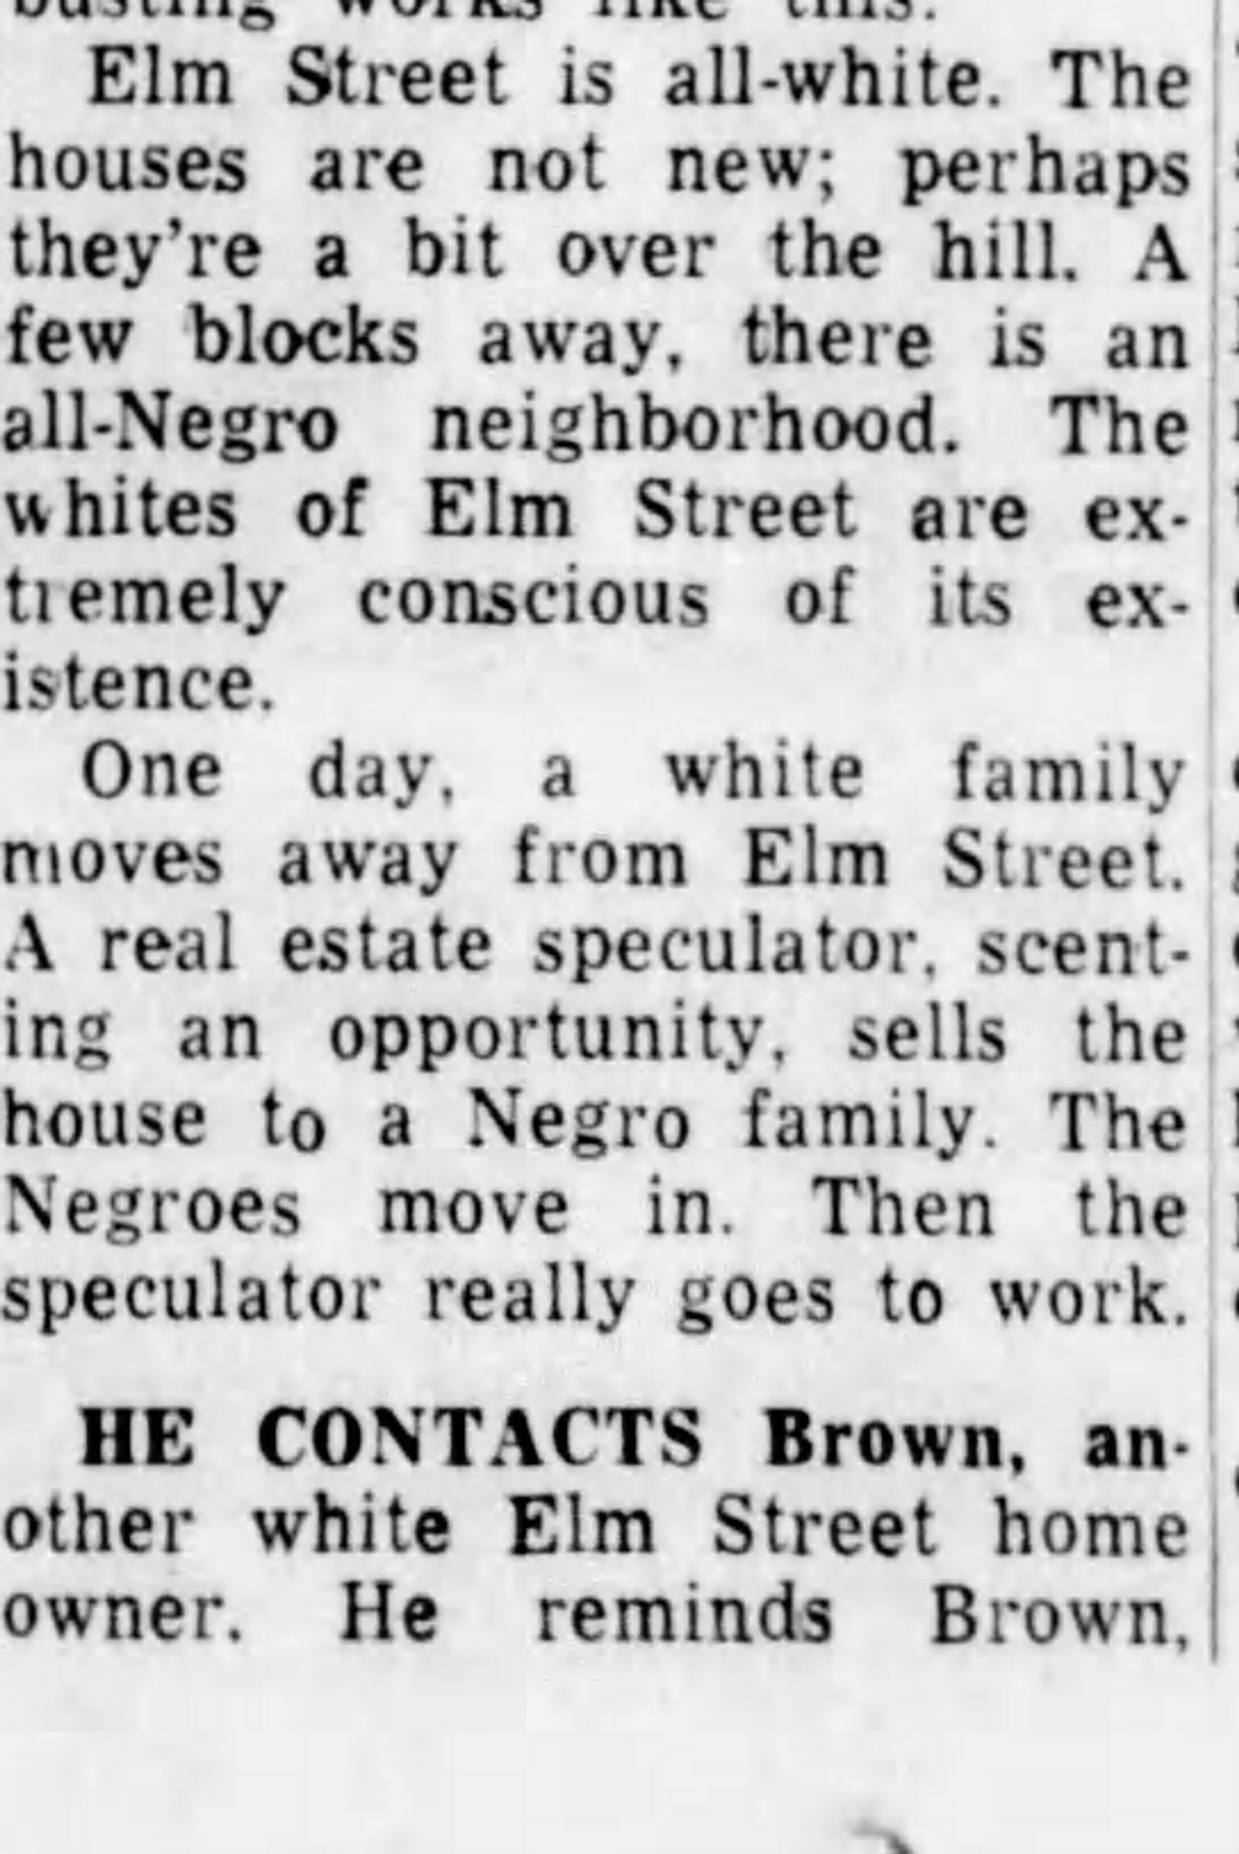
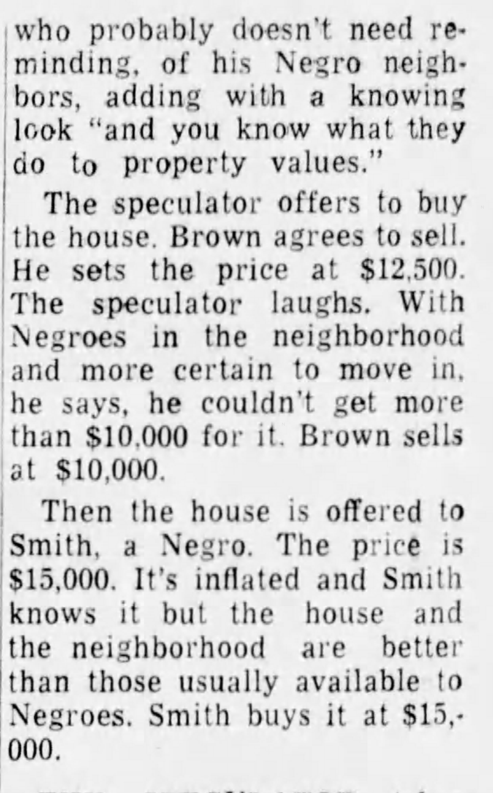
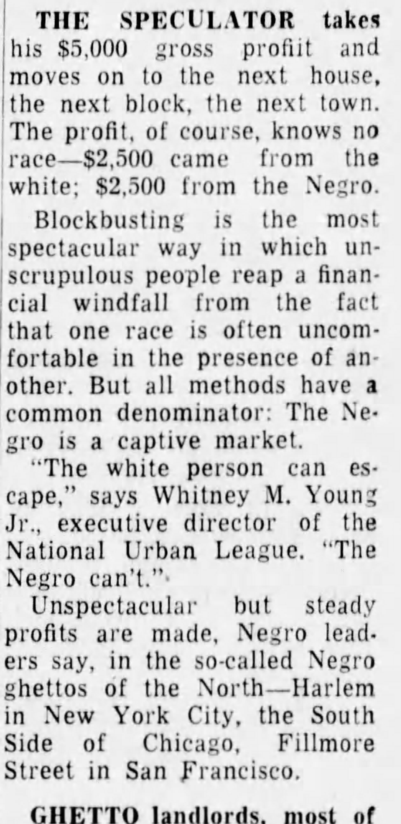
Which form of housing discrimination?

Slide 5
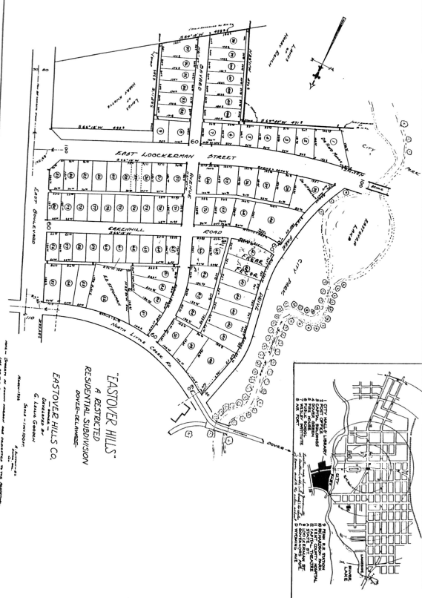
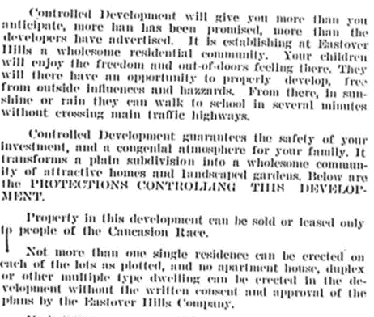
Which form of housing discrimination?

Slide 6
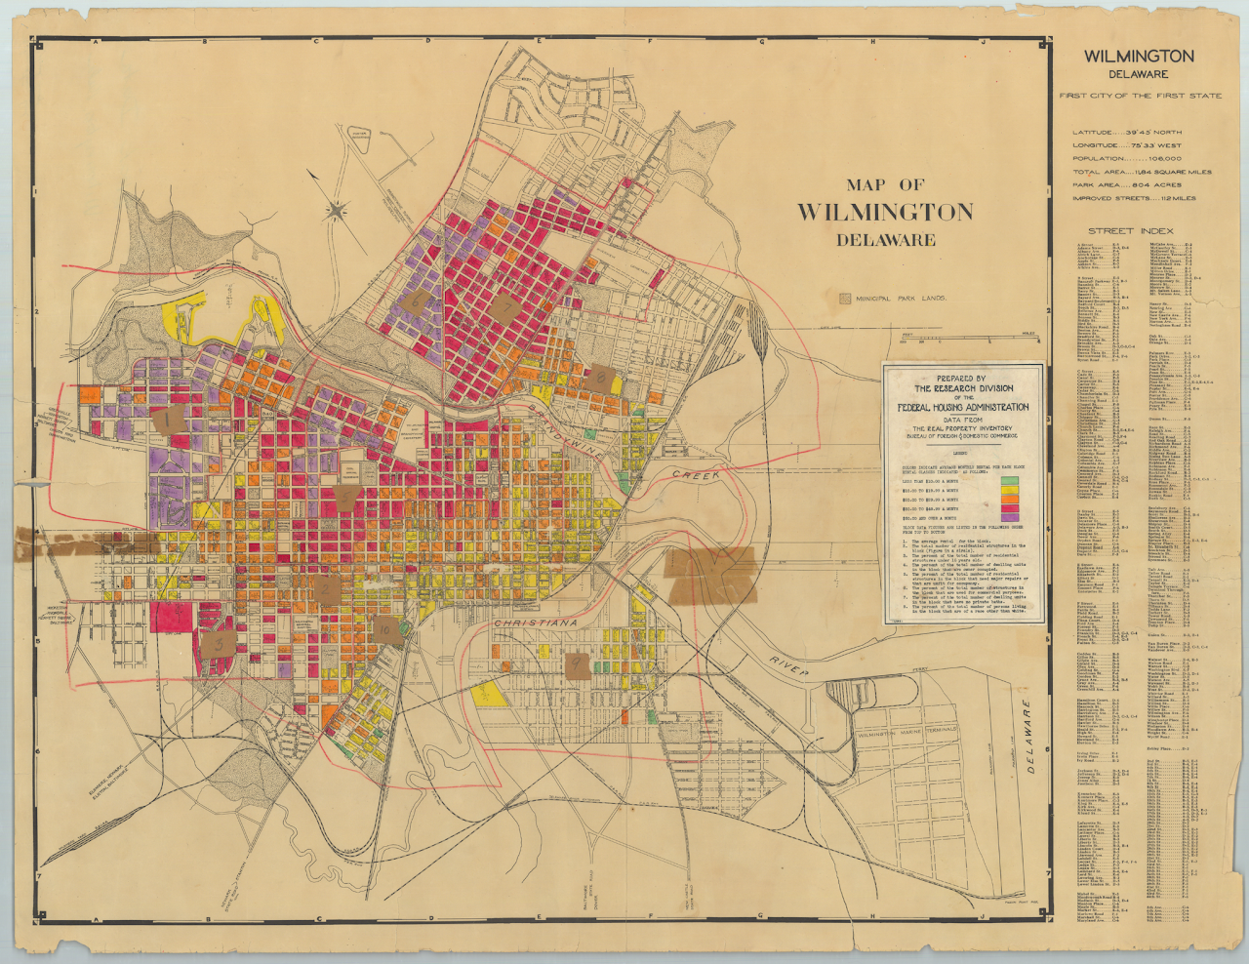
Which form of housing discrimination?
Notes:
https://www.redlininglab.org/

Slide 7
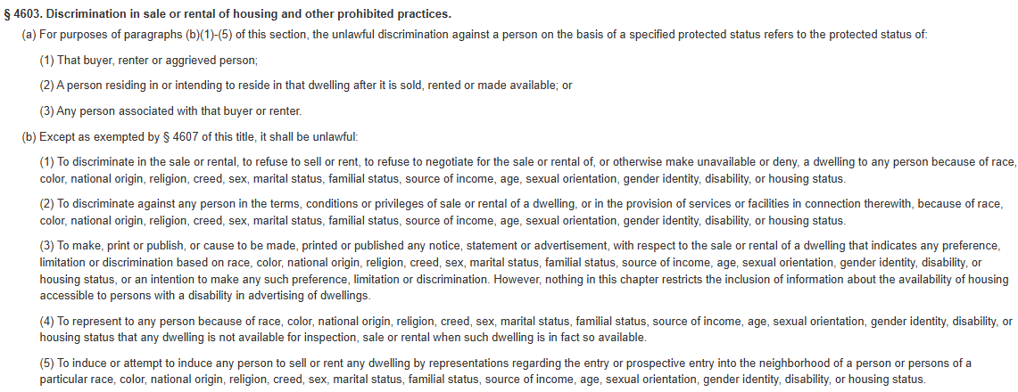
Delaware Fair Housing Act TITLE 6
Commerce and Trade
SUBTITLE II
Other Laws Relating to Commerce and Trade
CHAPTER 46. Fair Housing Act
How does the law resolve the issues of housing discrimination?

Slide 8
Match the Source Race
Each group will start with 1 “clue” (a primary or secondary source)
You must match the source to the correct form of civic participation
Check with TEACHER before you stick the source to the civic participation poster
If you correctly ID the source, you will receive your next clue
There are 5 total for each group
Each source will come from a different from of civic participation.
Once you have used that form, you cannot use it again.
First group done with COMPLETE GRAPHIC ORGANIZERS wins!!!!

