Slide 1
Answer Key
Document Set 1
  Peaceful Assembly
  Working with a citizens group
  Sit Ins
  Letter writing
  Religious Organizations
Document Set 2
  Working with a citizens group
  Peaceful Assembly
  Sit In
  Letter writing
  Religious Organization
Document Set 3
  Letter writing
  Sit Ins
  Commissions
  Working with a citizens group
  Peaceful Assembly

Slide 2
Peaceful Assembly

Slide 3
Working in a Citizens Group

Slide 4
Sit Ins

Slide 5
Letter Writing

Slide 6
Working with a Religious Organization

Slide 7
Working with a Commission Engaged in Public Policy

Slide 8
Document Set 1

Slide 9
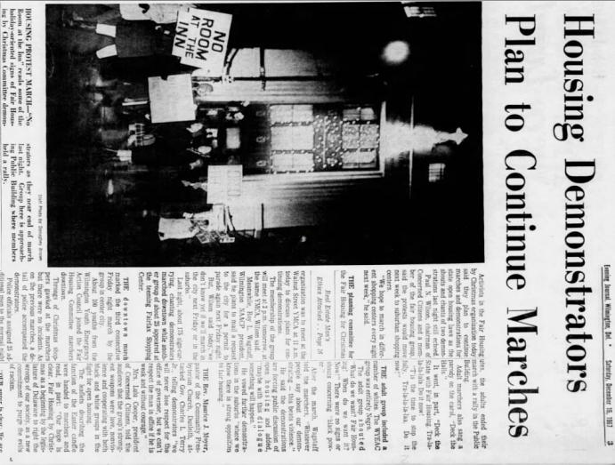
Document 1a
Peaceful Assembly
Notes:
The News Journal (Wilmington, Delaware) · Sat, Dec 16, 1967 · Page 3

Slide 10
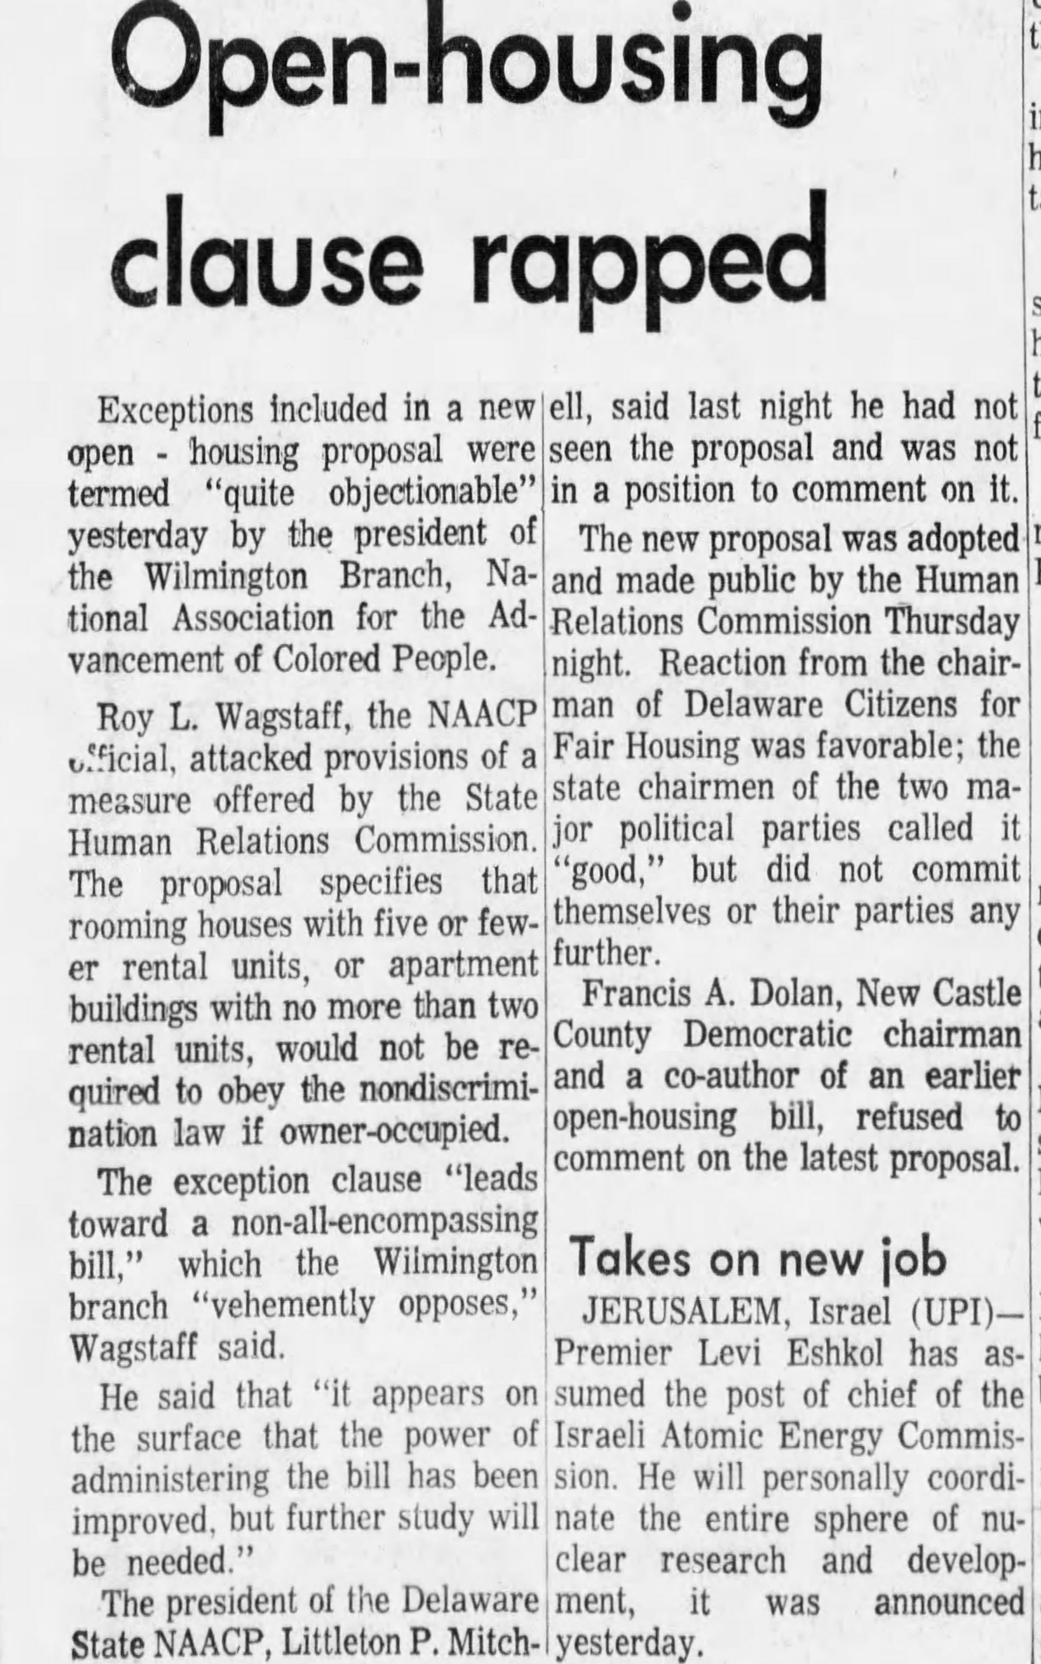
Document 1b
Working with a Citizens Group
Notes:
The Morning News
Sat, Apr 16, 1966 ·Page 13

Slide 11
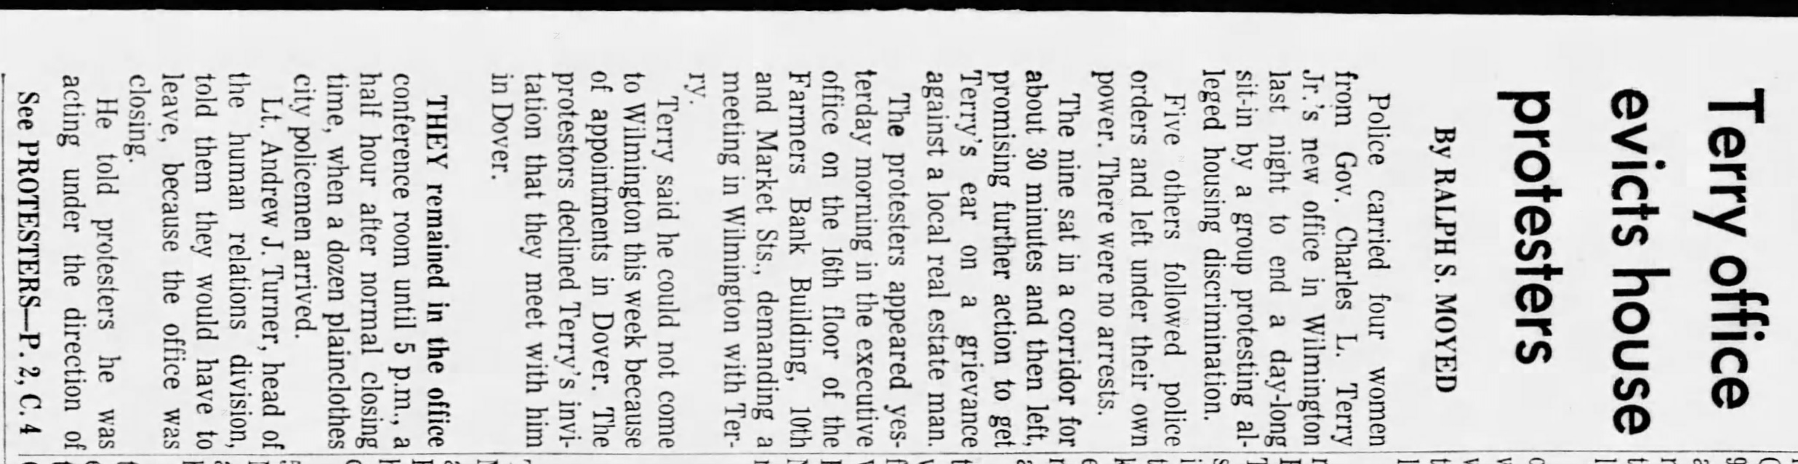
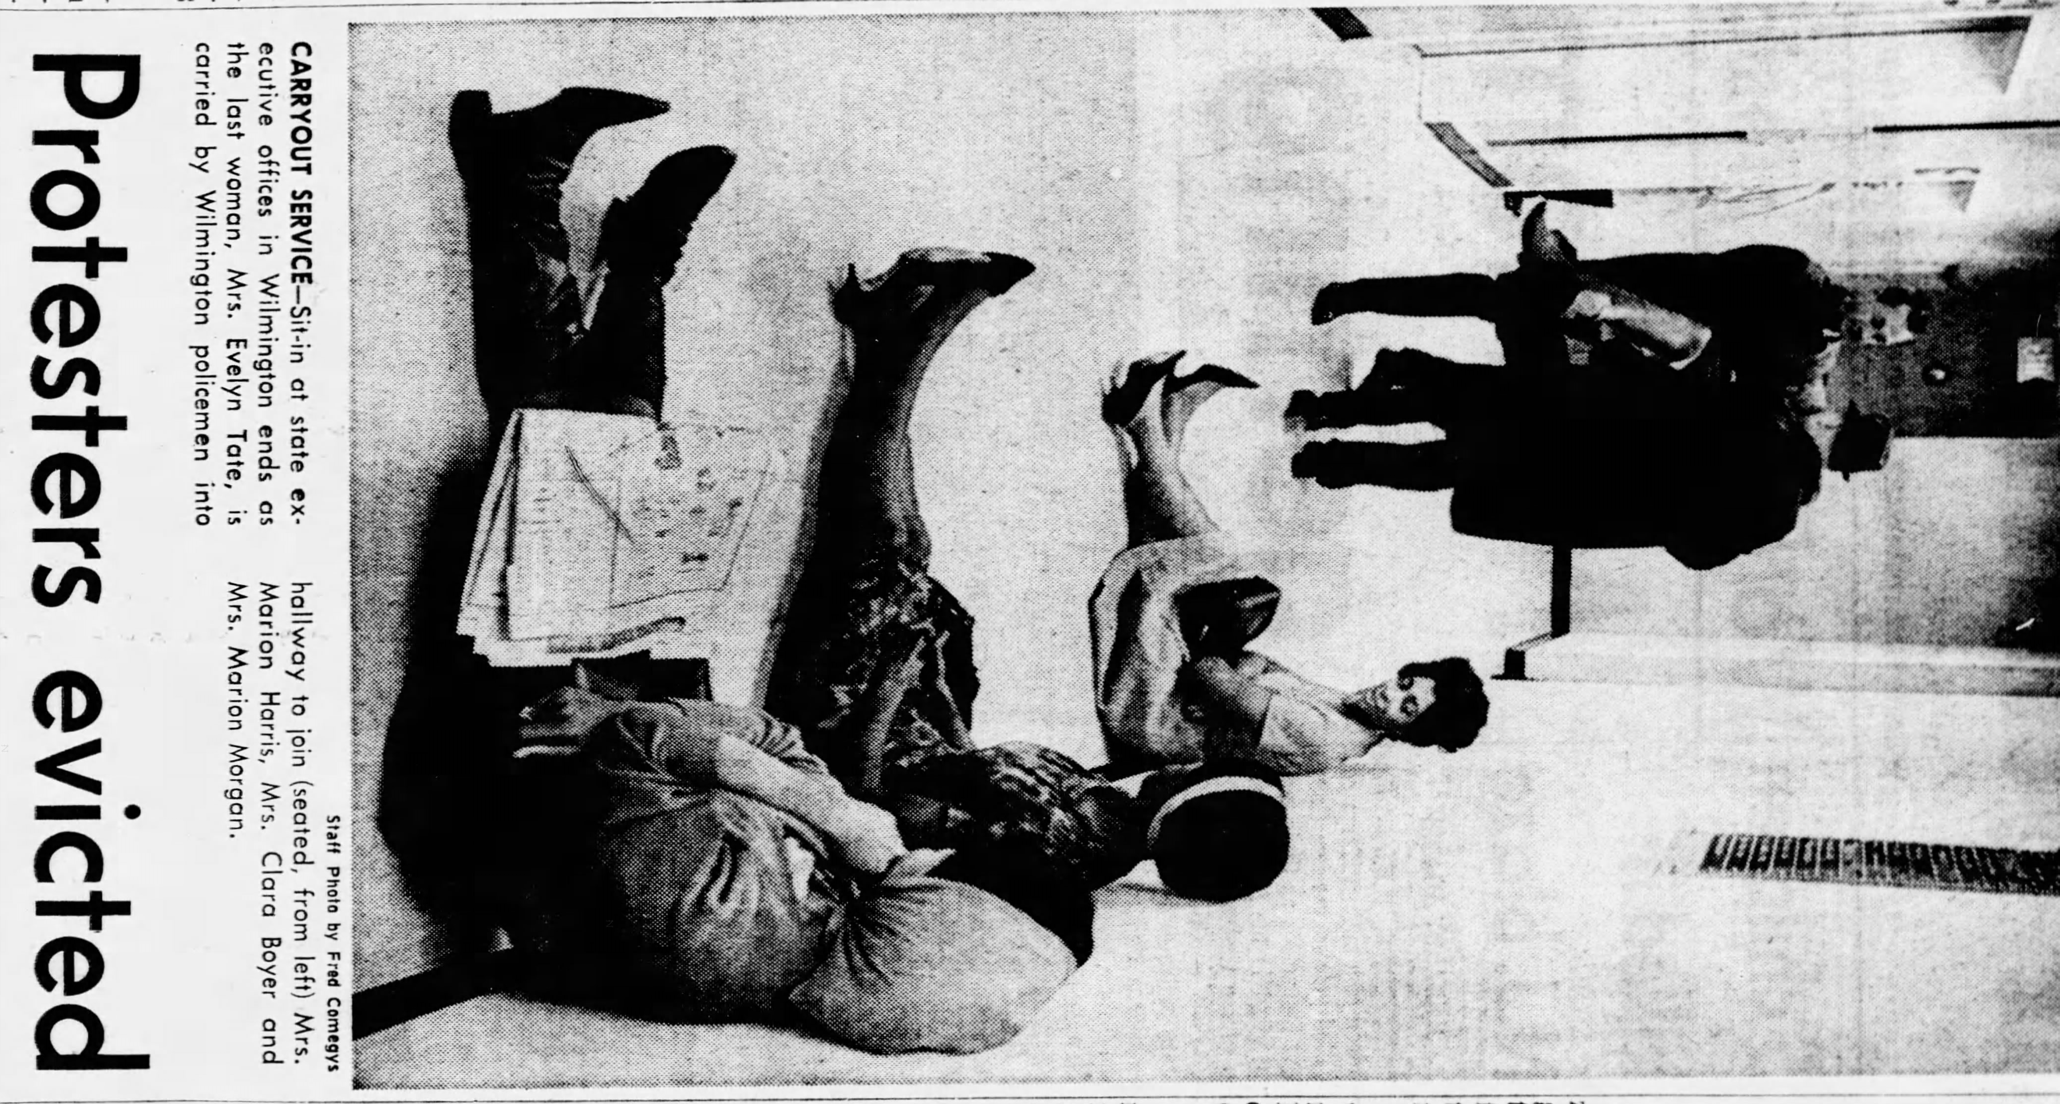
Document 1c
Sit Ins
Notes:
The Morning News
Tue, Nov 28, 1967 ·Page1 and 2

Slide 12
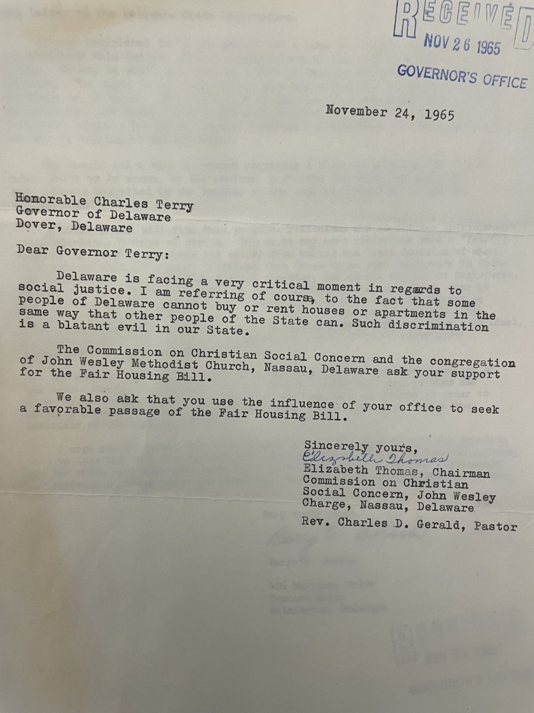
Document 1d
Letter Writing

Slide 13
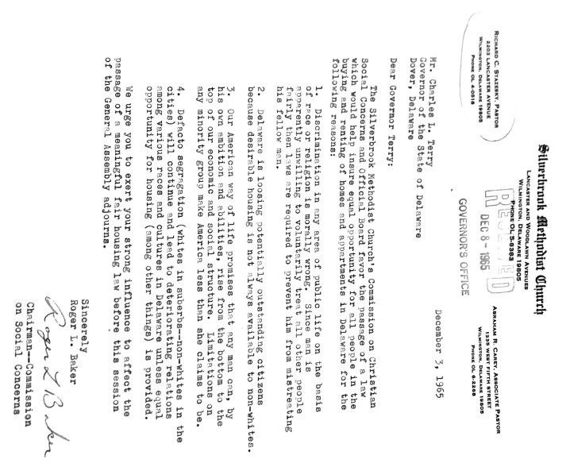
Document 1e
Religious Organizations

Slide 14
Document Set 2

Slide 15
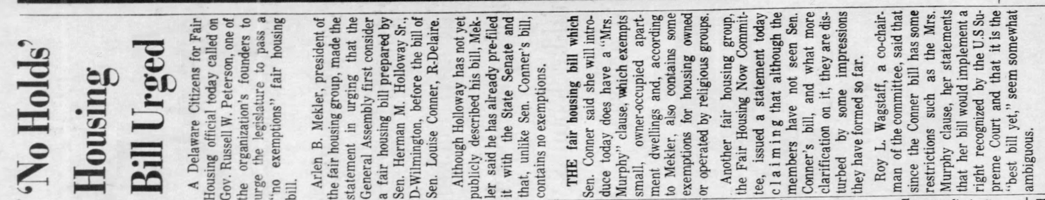
Document 2A
Working with a Citizens Group
Notes:
The News Journal (Wilmington, Delaware) · Tue, Mar 4, 1969 · Page 10

Slide 16
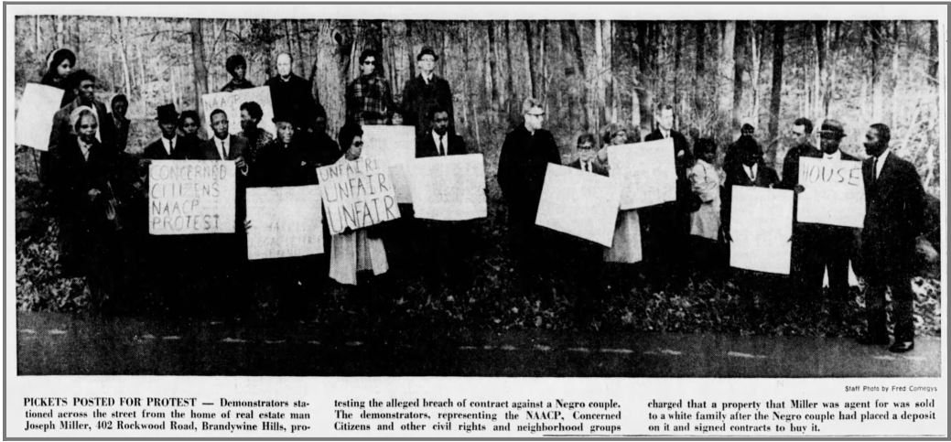
Document 2b
Peaceful Assembly
Notes:
The News Journal (Wilmington, Delaware) · Mon, Nov 27, 1967 · Page 3

Slide 17
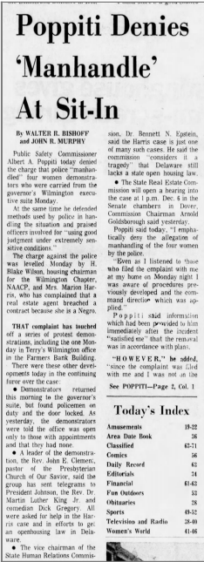
Document 2c
Sit Ins
Notes:
The News Journal (Wilmington, Delaware) · Thu, Nov 30, 1967 · Page 1

Slide 18
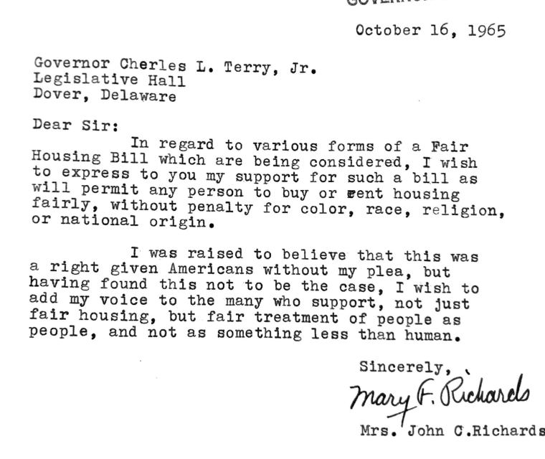
Document 2d
Letter Writing

Slide 19
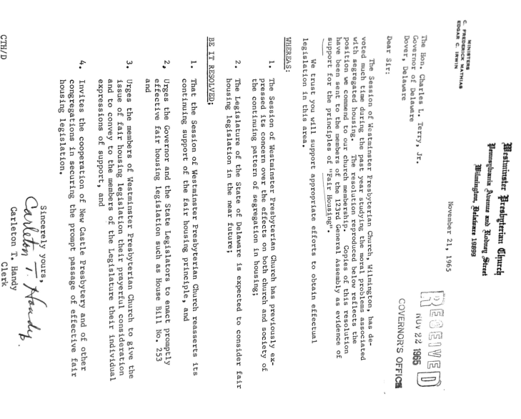
Document 2e
Religious Organizations

Slide 20
Document Set Three

Slide 21
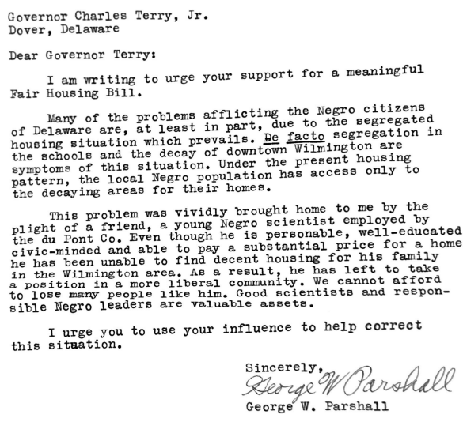
Document 3a
Letter Writing

Slide 22
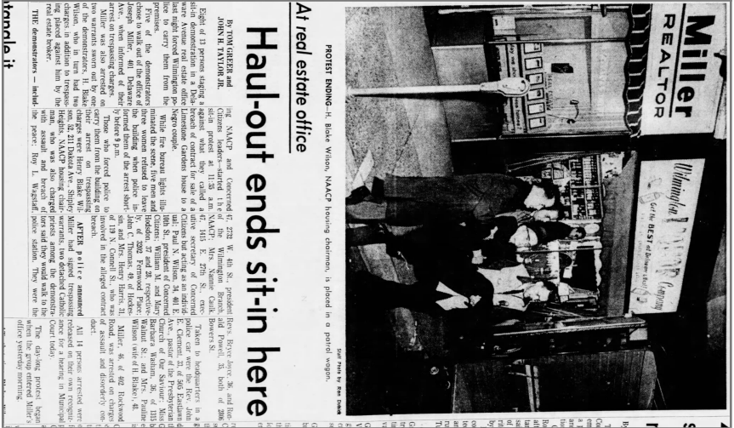
Document 3b
Sit Ins
Notes:
The Morning News (Wilmington, Delaware) · Sat, Nov 25, 1967 · Page 1

Slide 23
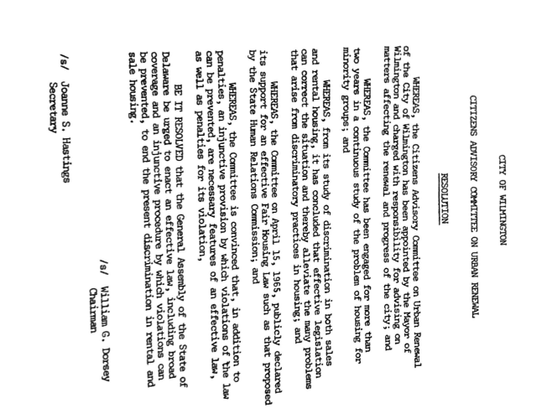
Document 3c
Working with a commission engaged in public policy

Slide 24
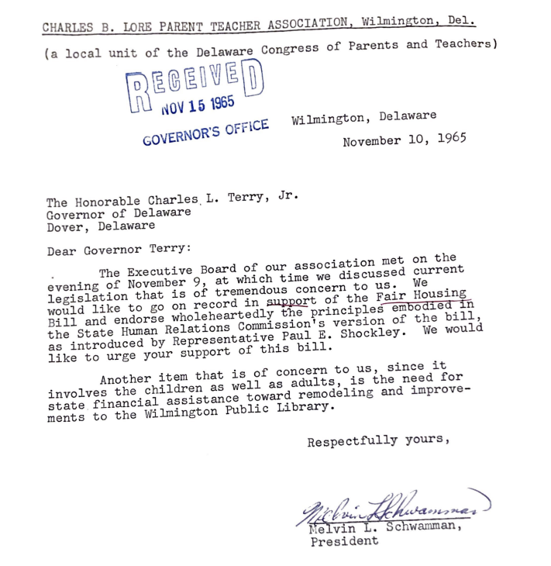
Document 3d
Working with a Citizens Group

Slide 25
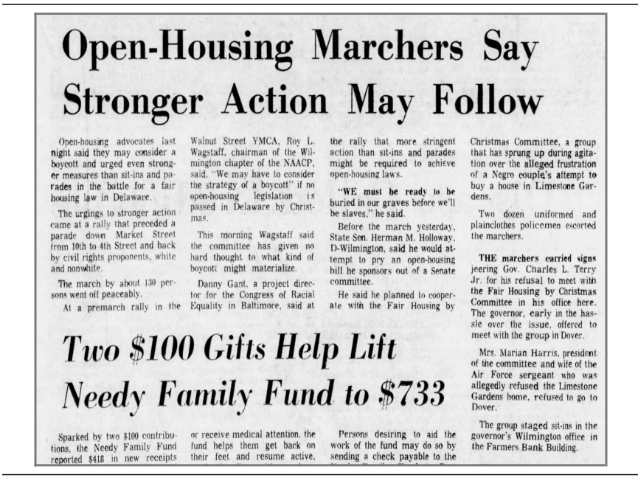
Document 3e
Peaceful Assembly
Notes:
The News Journal (Wilmington, Delaware) · Sat, Dec 2, 1967 · Page 1

Slide 26
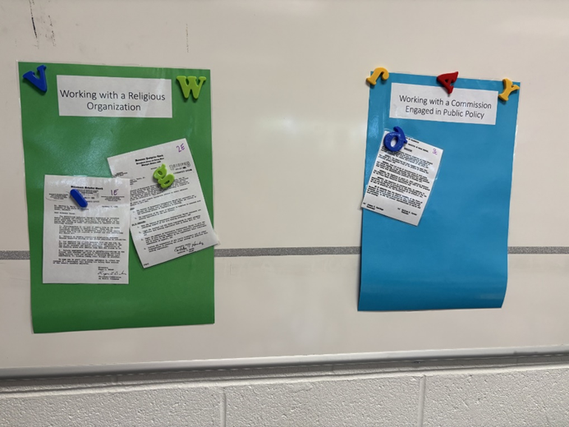
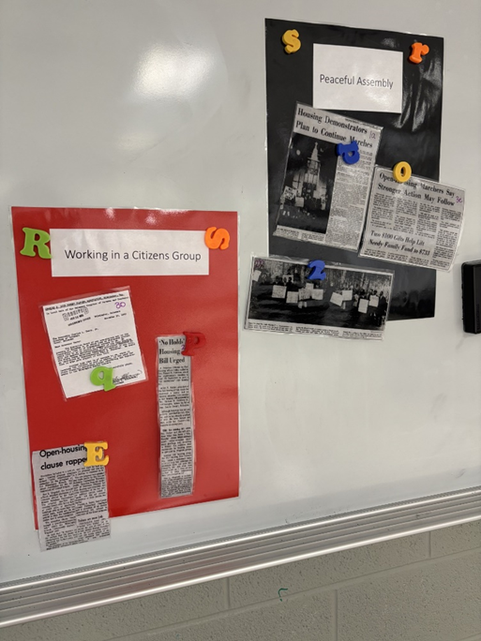
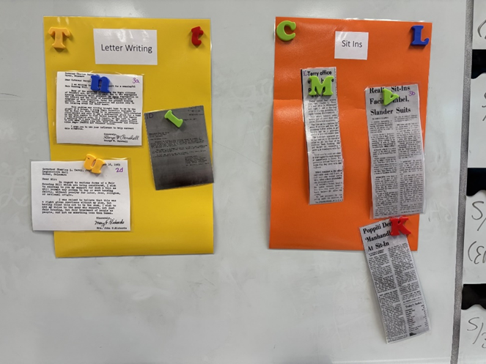
Notes:
Some articles are different in this image then the document sets. This is just to see a visual of the final outcome

