Slide 1

Declaration of Independence
Lesson Details

Slide 2
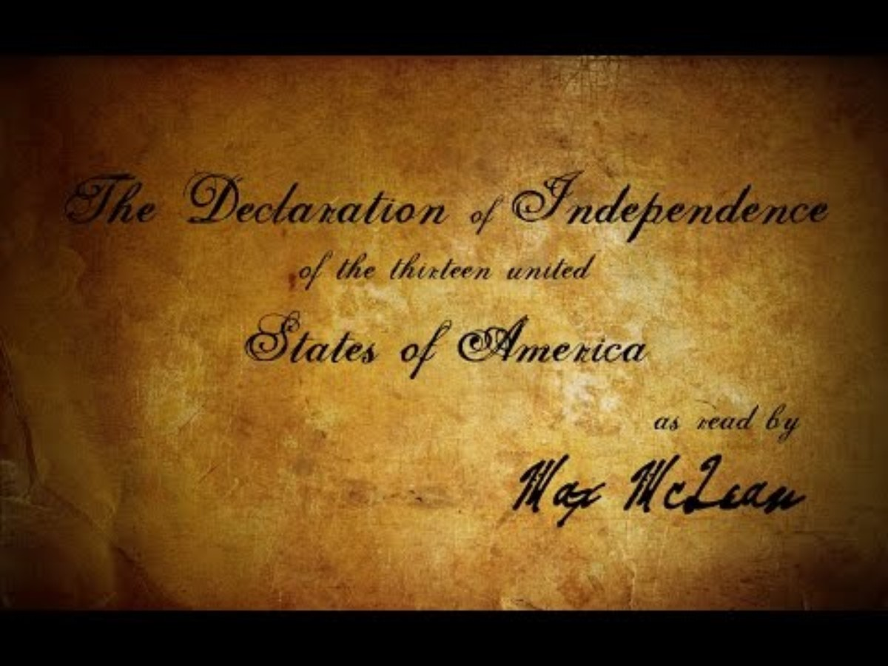
Declaration of Independence Video and Audio

Slide 3
Vocabulary Words for the following lesson:
Trade
Independence Patriot Inalienable Abdicate Standing Armies Trial by Jury Consent Plundered Ravaged Depriving Representative Houses Quartering

Slide 4
Warm Up:
Prompt: Analyze a complaint that a colonist had and answer the following questions.
What is the objective of this complaint?
What impact do you think these policies had on the colonist life?
The Following Complaints include:
He has kept among us, in times of peace, Standing Armies without the Consent of our legislatures.
For depriving us in many cases, of the benefits of Trial by Jury
He has plundered our seas, ravaged our Coasts, burnt our towns, and destroyed the lives of our people.
He has abdicated Government here, by declaring us out of his Protection and waging war against us.
He has dissolved Representative Houses repeatedly, for opposing with manly firmness his invasions on the rights of the people.
He has made judges dependent on his Will alone, for the tenure of their offices, and the amount and payment of their salaries.

Slide 5
Activity:
Prompt: Create a list of 2-3 complaints you have about your school rules or policies.
What would you want those complaints changed to?
And why?
Schools’ rules or policies you disagree with: | Alternatives to your schools’ rules or policies:

Slide 6
Research Activity:
Prompt: Pick 5 complaints from the list provided by your teacher, research what the national problem is, why that problem is important, and how might this problem be solved
The Following National Issues Include:
Inflation
Affordable Healthcare
The ability of Democrats and Republicans to work together
Drug Addiction
Gun Violence
Violent Crime
The federal budget deficit
The state of moral values
The quality of public k-12 schools
Illegal Immigration
Climate Change
Domestic Terrorism
Conditions of roads, bridges, and other infrastructures
International Terrorism
Unemployment
Racism

Slide 7
Final Product
For group Declaration use a piece of plane white paper or construction paper and write the national complaints you have in a numbered list.
For the whole class Declaration, you can use a big piece of pager or construction paper.
The class all together will debate what the 5 most important national issues are.

