Slide 1
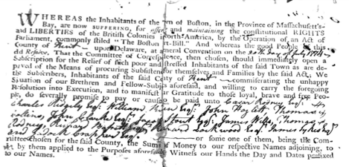
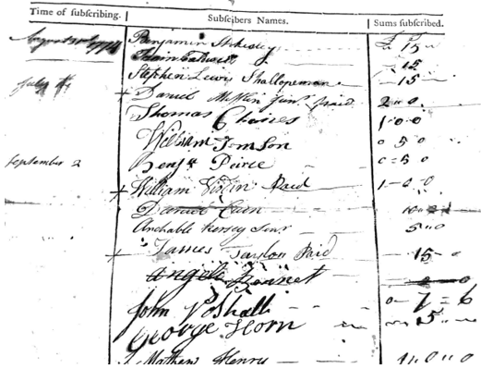
Form of Civic Responsibility?
Document A:
List of Subscriptions to aid citizens in Boston

Slide 2
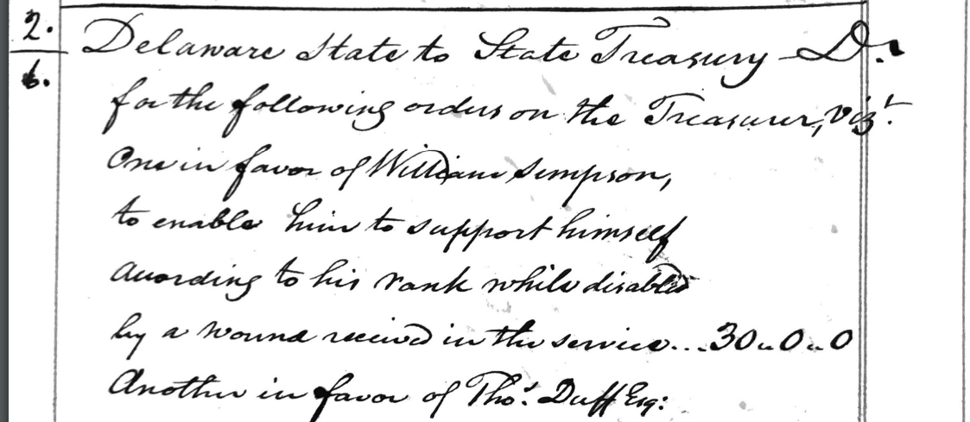
Form of Civic Responsibility?
Document B: Delaware Treasury Records list of payments for services during the Revolution
Delaware state to State Treasury D. for the following order on the Treasurer…
One in favor of William Simpson to enable him to support himself according to his rank while disable by a wound received in the service…30.0.0

Slide 3
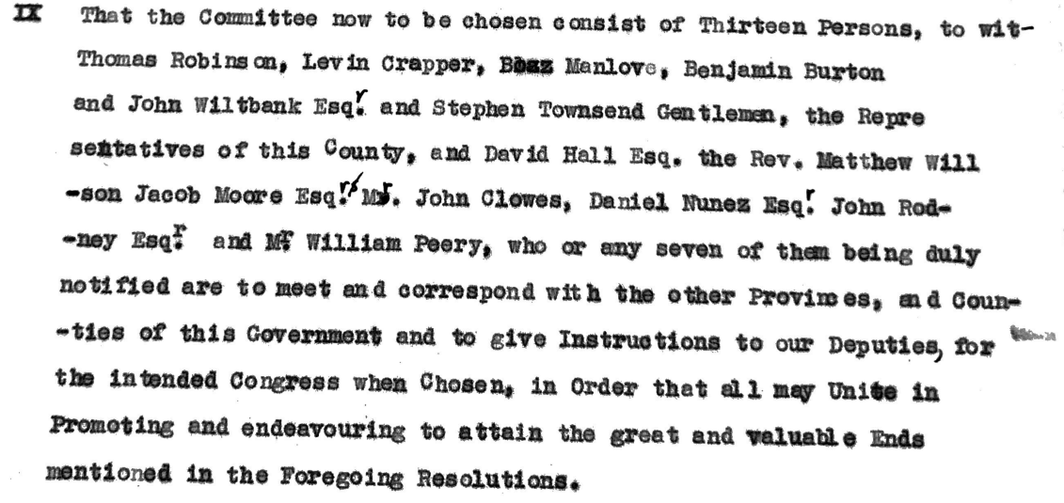
Form of Civic Responsibility?
Document C: July 1774 Records of the Delaware Committee of Correspondence

Slide 4
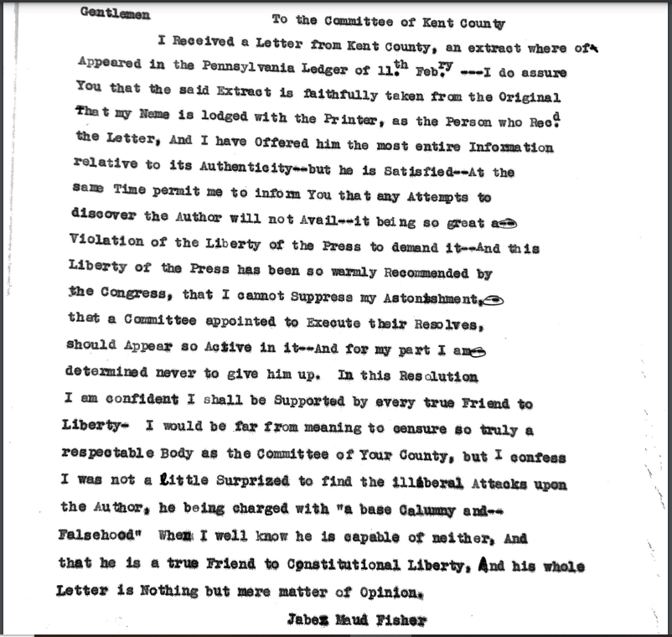
Form of Civic Responsibility?
Document D: March 1775 Records of the Delaware Committee of Correspondence

Slide 5
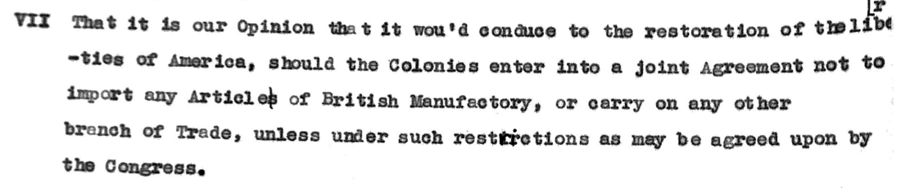
Form of Civic Responsibility?
Document E: July 1774 Records of the Delaware Committee of Correspondence

